Slide 1

MUS MUSCULUS
MAJOR PROJECT 1
TEAM D

Slide 2
CONTENTS
Problem Statement
Objective
Technology Used
Team Information
Steps Involved
Future Scope
Advantages
Challenges Faced
CONCLUSION

Slide 3
Problem Statement
The objective is to identify subsets of proteins that are discriminant between different classes of mice. The dataset includes protein expression levels in the cerebral cortex of both control and Down syndrome mice subjected to context fear conditioning. The aim is to classify the mice into eight distinct classes based on genotype, behaviour, and treatment.

Slide 4
Classify mice based on protein expression.
Identify key discriminant proteins.
Evaluate the impact of Genotype, Behavior and Treatment.
Objective

Slide 5


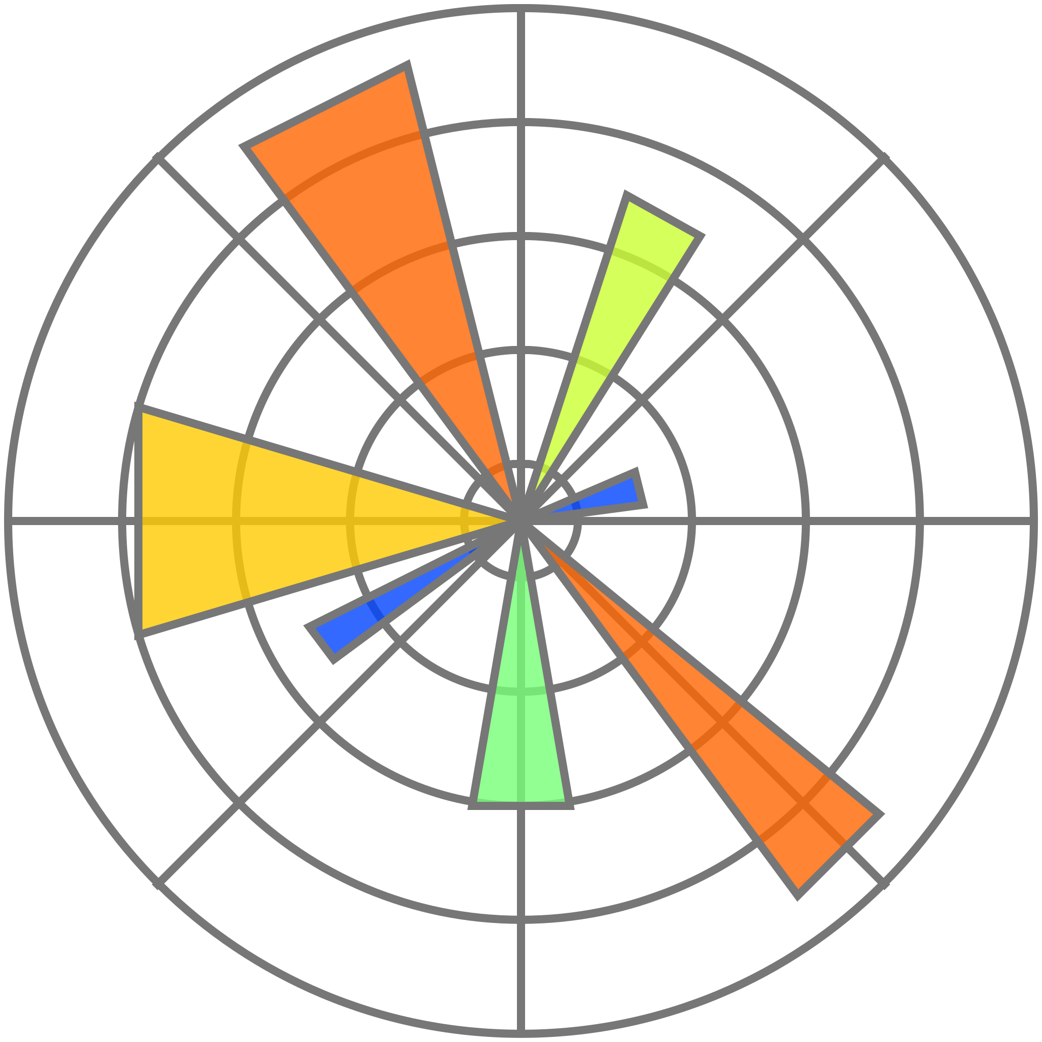

Technology Used
t2
t3
t4
Python
pandas
matplotlib
Sk-learn
Python is a popular high-level programming language known for its readability and simplicity.
Pandas is a powerful Python library for data manipulation and analysis.
Matplotlib is a comprehensive library for creating static, animated, and interactive visualizations in Python.
Scikit-learn is a popular machine learning library in Python that provides simple and efficient tools for data mining and data analysis.

Slide 6
Team Information
Gaurav Gaikwad
Varkala Sai Vignesh
Md Sahil Khan
Aditya Krishna
Manas Chauhan (Leader)
Vaishnavi Gagare (Co-Leader)
Shivani Kumari (Co-Leader)
Rohini Keshav Weldode
Mohit Tiwari
Anusha Vaidyan
Manish Kumar Yadav
Stephen Jamthianmuan
Devansh Maheshwari
Uday Krishnan

Slide 7
Attributes
Mouse ID
Values of expression levels of 77 proteins; the names of proteins are followed by N indicating that they were measured in the nuclear fraction. For example: DYRK1A_n
Genotype: control (c) or trisomy (t)
Treatment type: memantine (m) or saline (s)
Behavior: context-shock (CS) or shock-context (SC)
Classes
c-CS-s
c-CS-m
c-SC-s
c-SC-m
t-CS-s
t-CS-m
t-SC-s
t-SC-m

Slide 8
Steps Involved
Data Preprocessing
Exploratory Data Analysis (EDA)
Feature Selection
Model Training
Model Evaluation
Interpretation
Analysis

Slide 9
Dataset Description
The data set consists of the expression levels of 77 proteins/protein modifications that produced detectable signals in the nuclear fraction of cortex. There are 38 control mice and 34 trisomic mice (Down syndrome), for a total of 72 mice.
In the experiments, 15 measurements were registered of each protein per sample/mouse. Therefore, for control mice, there are 38x15, or 570 measurements, and for trisomic mice, there are 34x15, or 510 measurements.
The dataset contains a total of 1080 measurements per protein. Each measurement can be considered as an independent sample/mouse.
The eight classes of mice are described based on features such as genotype, behavior and treatment. According to genotype, mice can be control or trisomic.
According to behavior, some mice have been stimulated to learn (context-shock) and others have not (shock-context) and in order to assess the effect of the drug memantine in recovering the ability to learn in trisomic mice, some mice have been injected with the drug and others have not.

Slide 10
Data Preprocessing
Data Preprocessing refers to the cleaning, transforming, and integrating of data in order to make it ready for analysis. The goal of data preprocessing is to improve the quality of the data and to make it more suitable for the specific data mining task.

Slide 11
Flow Of Data Preprocessing
Handling missing values
It is a crucial part of data preprocessing to ensure that the data used for analysis or modeling is accurate and reliable.
Normalizing/Scaling the data
Normalizing or scaling data is a crucial step in data preprocessing, especially when dealing with machine learning algorithms that are sensitive to the scale of numerical input features.
Encoding categorical variables
Encoding categorical variables is a crucial step in data preprocessing for machine learning tasks, as many algorithms cannot directly handle categorical data in its raw form.

Slide 12
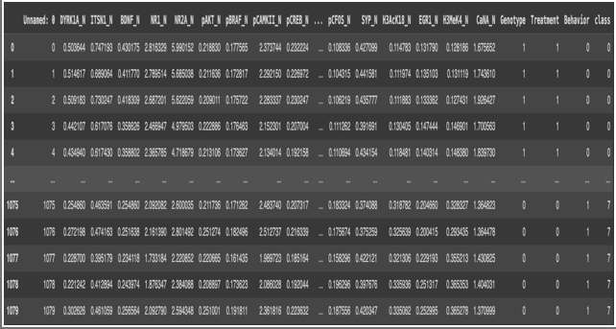
Dataset

Slide 13
Exploratory Data Analysis
The task is to perform exploratory data analysis to understand the distribution and relationships in the protein expression data. This includes calculating summary statistics, creating visualizations to explore data distributions, and analysing correlations between features.

Slide 14
Task Performed
Count: Indicates the number of non-null entries in each column (all columns have 1080 entries).
Mean: Represents the average value of the numerical columns (close to zero, indicating normalization).
Standard Deviation (Std): Measures the dispersion of the data from the mean (approximately 1, indicating normalization).
Minimum (Min) and Maximum (Max): Indicate the range of values for the protein levels.
Unique: Shows the number of unique categories in categorical columns.
Top: Indicates the most frequent category in categorical columns (e.g., 'c-CS-m' for
Class).
Frequency (Freq): Represents the frequency of the most frequent category (e.g., 150
occurrences of 'c-CS-m').

Slide 15
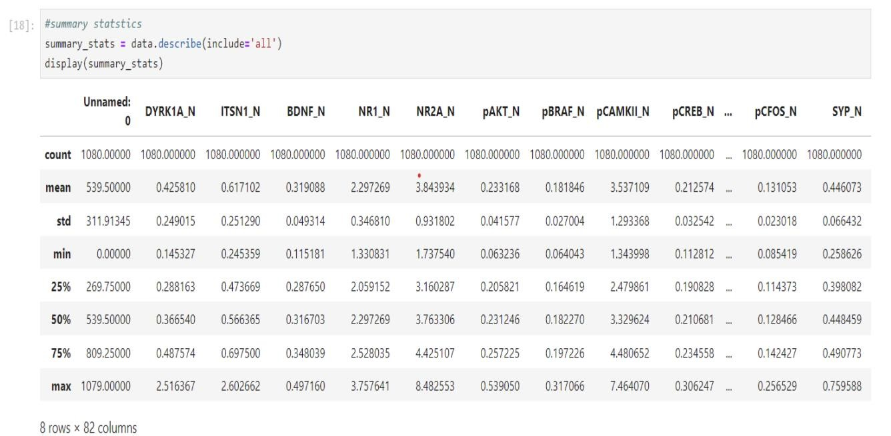
Output of the task performed

Slide 16
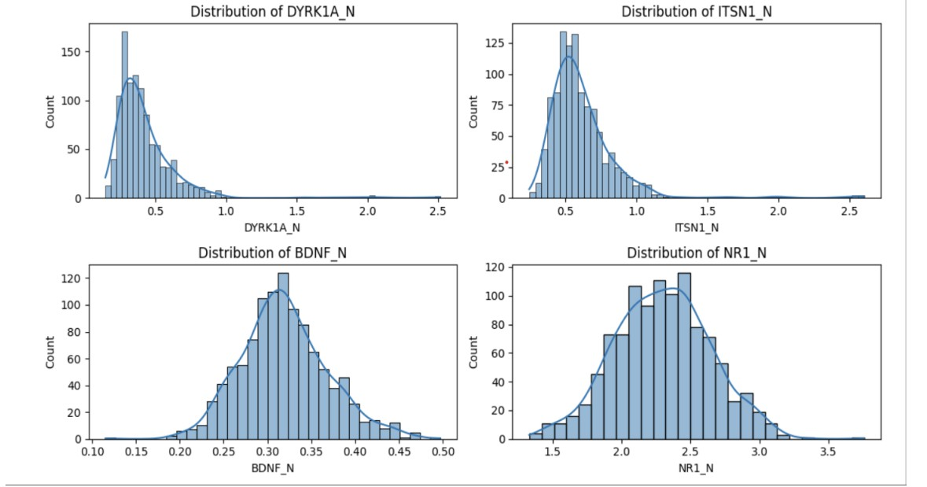
Visualizations
Histograms: The following histogram generates distribution plots for four key proteins in the dataset. These plots help visualize how the expression levels of these proteins are distributed across the sample. Each subplot displays a histogram representing the frequency of different expression levels for the respective protein.
Kernel Density Estimate: A smoothed curve over the histogram that shows the estimated probability density of the protein expression levels. This helps in visualizing the shape of the distribution more clearly

Slide 17
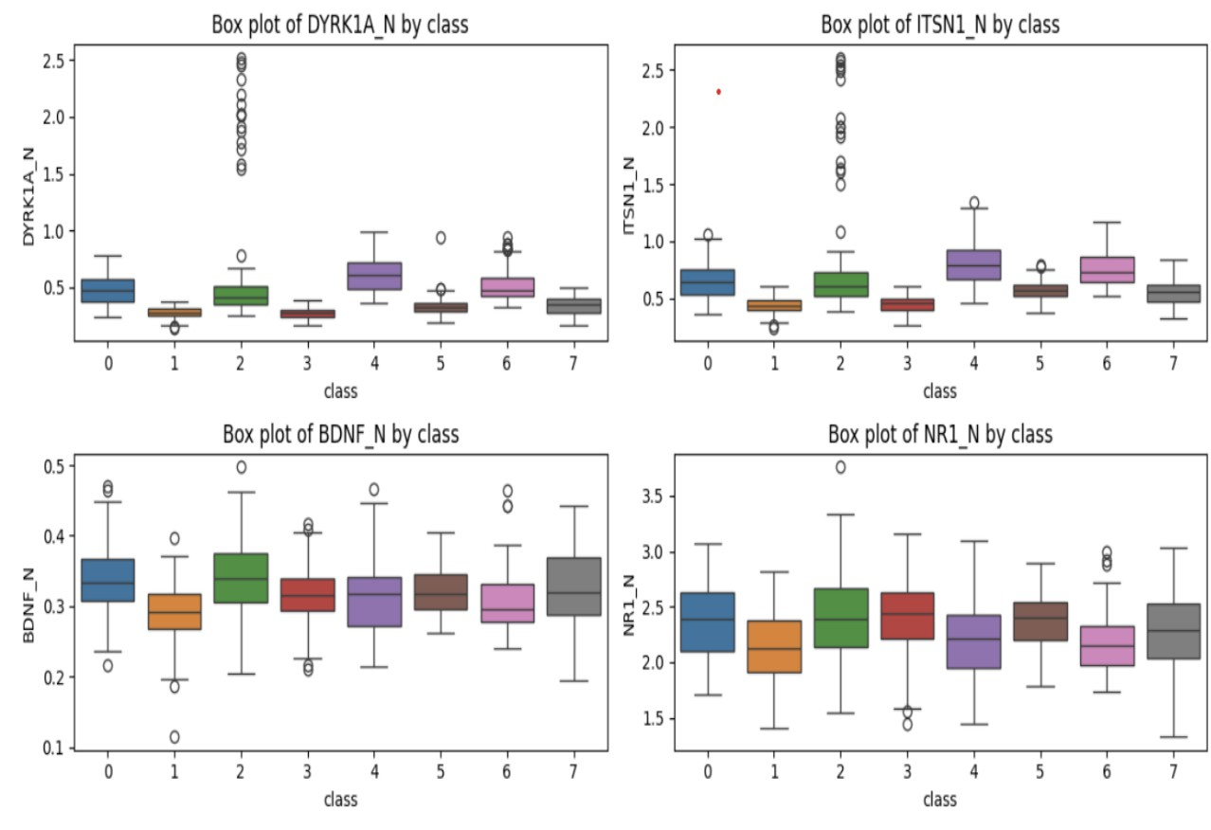
Median Expression Levels: The central line in each box represents the median expression level of BDNF_N for each class. Variations in these median lines across classes indicate differences in central tendency, suggesting that BDNF_N levels differ depending on the class.
Box Plots: These are excellent for detecting outliers in the dataset. Outliers are data points that fall outside the typical range of the dataset and can significantly influence the results of data analysis. In the context of protein expression levels, outliers may indicate mice with atypical protein expression that could be of particular biological interest.

Slide 18
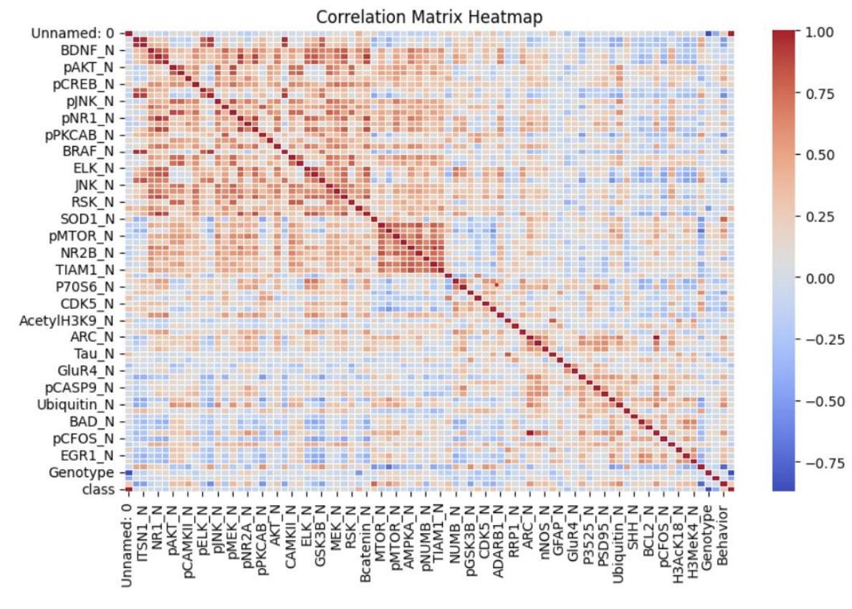
Correlation Matrix
• +1 indicates a perfect positive linear relationship (both variables increase together).
-1 indicates a perfect negative linear relationship (one variable increases while the other decreases).
0 indicates no linear relationship.

Slide 19
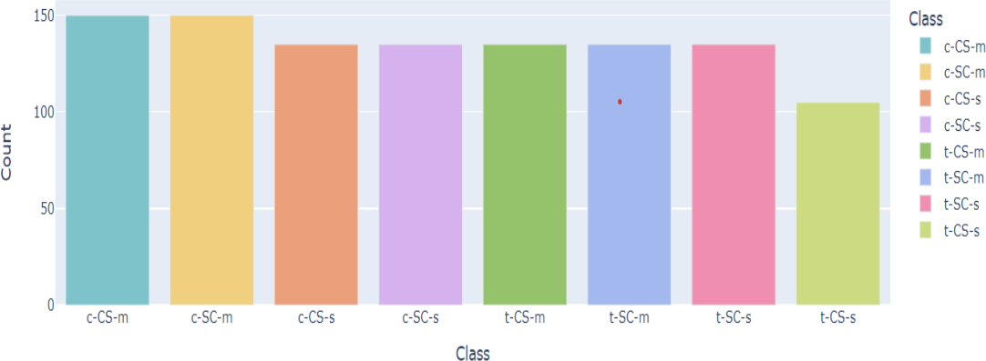
Class Distribution
It refers to how the different categories (or classes) are represented in the dataset. For example, if you have 8 different classes of mice based on genotype, behavior, and treatment, the class distribution would show how many samples belong to each of these classes.

Slide 20
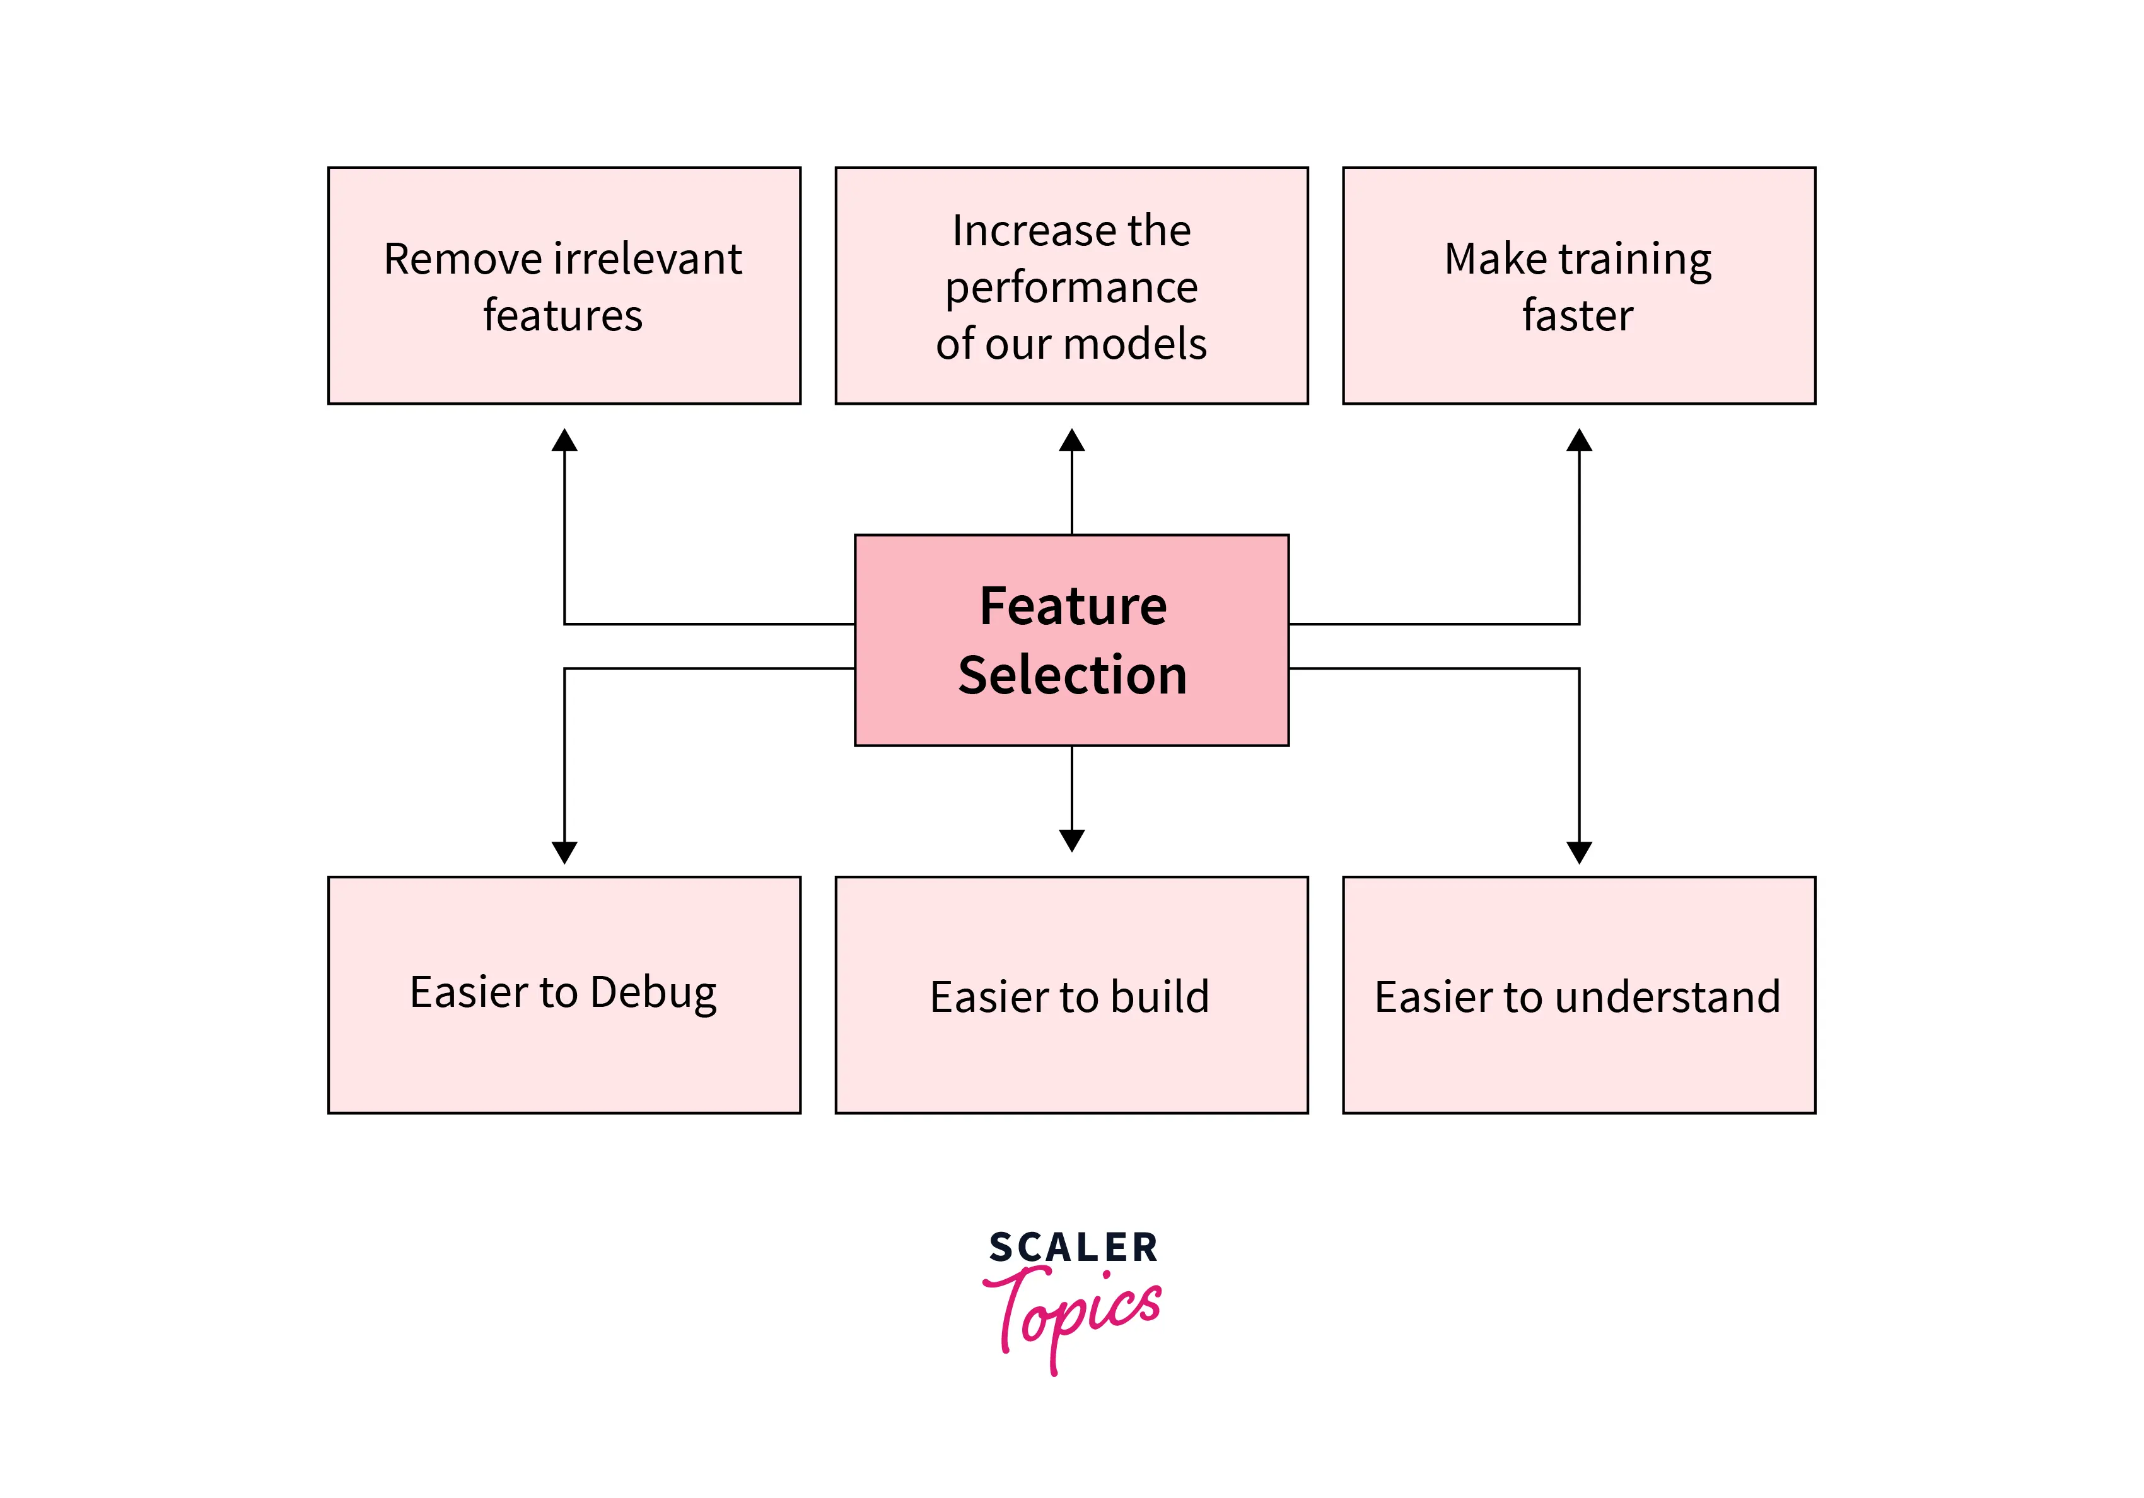
Feature Selection
To reduce the dimensionality of feature space.
To speed up a learning algorithm.
To improve the predictive accuracy of a classification algorithm.
To improve the comprehensibility of the learning results.

Slide 21
Tasks Performed
Random Forest Feature Importances: Identified top features based on importance scores.
Recursive Feature Elimination (RFE) with Logistic Regression: Selected top 10
features.
Lasso Regularization: Identified nonzero coefficients as significant features.
Gradient Boosting and Extra Trees Classifiers: Ranked features based on
importance scores.
Combined Feature Importances: Averaged importance scores from Random
Forest, Gradient Boosting, and Extra Trees.

Slide 22
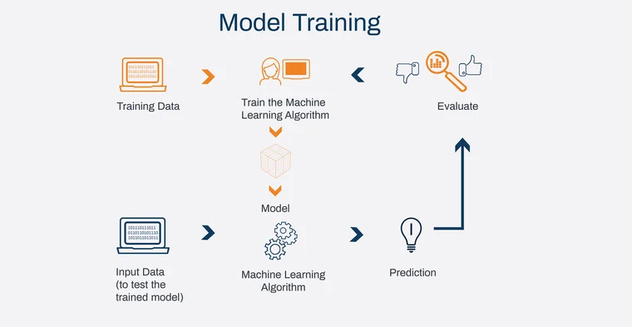
Model Training
The MODEL TRAINING task involves training and evaluating multiple machine learning classification algorithms to determine the best performing model for a given dataset. The models evaluated include Logistic Regression, K-Nearest Neighbours, Support Vector Classifier, Decision Tree, Random Forest, Naive Bayes, and AdaBoost. Additionally, hyperparameter tuning is performed to further optimize model performance.

Slide 23
Steps Taken to Complete Task
Data Loading and Preprocessing
- Data is loaded and split into training and testing sets.
Model Training
- Various classification algorithms are defined and trained on the training data.
- Evaluation metrics (accuracy, precision, recall, F1 score) are calculated for each model.
- Confusion matrices and classification reports are generated and analyzed.
Hyperparameter Tuning
RandomizedSearchCV is used to perform hyperparameter tuning for Decision Tree, Random Forest, Logistic Regression, Support Vector Machine, Naive Bayes, and AdaBoost classifiers.
- Best parameters are identified, and models are re-evaluated with these parameters.
Performance Comparison
- Metrics for each tuned model are compared and visualized

Slide 24
Key Insights
Logistic Regression, Support Vector Classifier, Decision Tree, Random Forest, Naive Bayes, and AdaBoost achieved perfect metrics initially, indicating that the dataset is likely well-suited for these models.
K-Nearest Neighbors showed slightly lower performance, indicating sensitivity to the choice of neighbors and data scaling.
Hyperparameter tuning is crucial for enhancing model performance, but careful selection and validation are essential to avoid adverse effects.
Output Observations
Best Model Pre-Tuning: Logistic Regression, Support Vector Classifier, Decision Tree, Random Forest, Naive Bayes, and AdaBoost (all achieved perfect scores).
Best Model Post-Tuning: Random Forest achieved perfect scores with optimized parameters, indicating robustness and effectiveness of the hyperparameter tuning process.

Slide 25
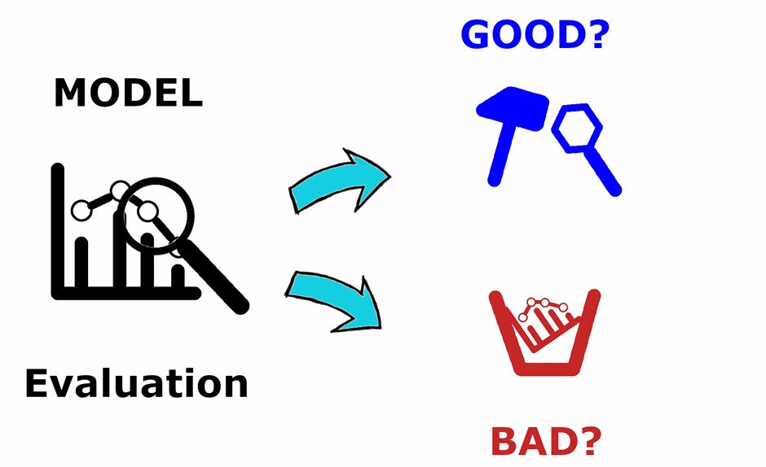
Model Evaluation
Model evaluation is the process of using different evaluation metrics to understand a machine learning model’s performance, as well as its strengths and weaknesses. Model evaluation is important to assess the efficacy of a model during initial research phases, and it also plays a role in model monitoring.

Slide 26
Techniques
Accuracy: The ratio of correctly predicted instances to the total instances.
Accuracy=TP + TN / Total instances
Precision: The ratio of true positive predictions to the total predicted positives.
Precision= TP/TP+FP
Recall: The ratio of true positive predictions to the actual positives.
Recall = TP/TP+FN
F1 Score: The harmonic mean of precision and recall
F1 Score = 2* Precision *Recall/ Precision + Recall
Specificity: The ratio of true negative predictions to the actual negatives.
Specificity = TN / TN+FN
ROC-AUC: Measures the ability of the model to distinguish between classes.
AUC ranges from 0 to 1, with 1 being perfect classification.
Confusion Matrix: A table showing the true positives, true negatives, false positives, and false negatives.

Slide 27
Steps Involved
Define the Classification Problem: Specify the classes and the dataset.
Split the Dataset: Divide the data into training and testing sets.
Train the Model: Use a chosen classification algorithm to train the model on the training set.
Make Predictions: Use the trained model to predict the class labels on the test set.
Evaluate the Model: Calculate each of the metrics mentioned using the predictions and the actual class labels from the test set.
Analyze the Results: Interpret the metrics to understand the model's performance

Slide 28
Key Insights
Accuracy: Provided a general sense of performance but was misleading for imbalanced data.
Precision and Recall: Highlighted the trade-offs between false positives and false negatives,
crucial for applications like spam detection and disease diagnosis.
F1 Score: Offered a balanced measure, especially useful when both precision and recall are important.
Specificity: Was particularly important in scenarios where the cost of false positives is high.
ROC-AUC: Gave a single performance measure across all thresholds, useful for comparing .

Slide 29

INTERPRETATION
The primary goal of this project is to identify subsets of proteins that are discriminant between different classes of mice based on their genotype, behavior, and treatment. The dataset includes protein expression levels in the cerebral cortex of both control and Down syndrome mice subjected to context fear conditioning. The classification task involves categorizing the mice into eight distinct classes.
This project demonstrates the ability to classify mice based on protein expression levels using machine learning techniques. The identified key proteins and the impact of various factors offer important information for further biological research. The findings provide valuable insights into the biological mechanisms underlying learning and memory in Down syndrome and can aid in the development of potential therapeutic strategies.

Slide 30
FUTURE SCOPE
Enhanced Understanding of Biological Mechanisms: Further research can leverage the identified discriminant proteins to gain deeper insights into the biological mechanisms underlying learning and memory, particularly in Down syndrome.
Advanced Therapeutic Strategies: Findings can contribute to the development of targeted therapies for Down syndrome, focusing on proteins that significantly impact learning and memory.
Integration with Omics Data: Combining protein expression data with other omics data (e.g., genomics, transcriptomics) can provide a more comprehensive understanding of the biological processes.
Improved Classification Models: Utilizing more advanced machine learning and deep learning techniques can enhance the accuracy and robustness of classification models.

Slide 31
ADVANTAGES
Biological Insights: Identifying key proteins provides valuable information on the biological pathways involved in learning and memory, offering potential targets for therapeutic intervention.
Personalized Medicine: The ability to classify mice based on protein expression paves the way for personalized treatment strategies, optimizing therapeutic outcomes for individuals with Down syndrome.
Data-Driven Decision Making: The project exemplifies the power of data analytics in making informed decisions, driving both scientific discovery and practical applications in medicine.

Slide 32
CHALLENGES FACED
Data Quality and Preprocessing: Handling missing values, scaling, and encoding categorical variables requires careful preprocessing to ensure the quality and reliability of the data.
Model Interpretability: Understanding and interpreting the results from complex machine learning models can be challenging, necessitating the use of feature importance and other interpretability techniques.
Generalization: Ensuring that the models generalize well to new, unseen data is crucial. This involves robust cross-validation and possibly the use of more sophisticated models.

Slide 33
CONCLUSION
This project demonstrates the potential of machine learning in classifying mice based on protein expression levels and identifying key discriminant proteins.
The insights gained can significantly contribute to understanding Down syndrome and developing effective therapies.
Future work can expand on these findings, exploring new research avenues and improving classification methodologies.

Slide 34


